Slide 1
FitNutriX: A web app for BMI calculation and workout logging
1146 | Tejesh Shrestha
Final Defense – DWIT-035– Class of 2025

Slide 2
Outline
Introduction
Problem Statement
Objective
Scope
Literature Review/Background Study
Methodology
Tools and Technology
Result
Conclusion
Reference

Slide 3
Introduction
FitNutriX is a web based app developed to assist users with their health and fitness goals. With features like BMI calculation, Nutrition Value Table and Workout Logging, this application aims to empower users to make informed decisions about their fitness journey and maintain a healthy lifestyle.

Slide 4
Problem Statement
Lack of active lifestyle
Obesity and diseases caused due to it
Improper form during workouts
Lack of intake of a balanced diet

Slide 5
Objective
To develop a web application for users to effectively manage and monitor their fitness goals.
To provide users with an accurate tool for the measurement of Body Mass Index (BMI).
To enable users to access correct nutritional values of several food items.
To provide users with an easy to use UI for workout logging and viewing.

Slide 6
Scope
User Registration
Body Mass Index Monitoring
Integration of a Balanced Diet
Regular Workout Logging

Slide 7
Literature Review/Background Study
The literature was categorized into three main themes: Health and Fitness Tracking, Nutritional Information, and Workout Logging. The FitnutriX web app integrates all these features into a centralized platform for it’s users.

Slide 8
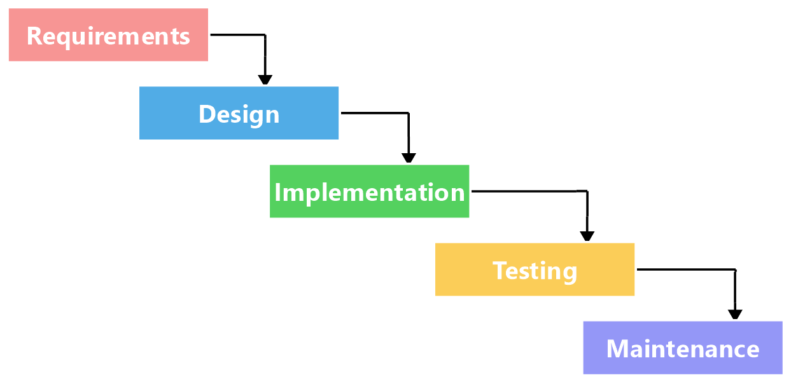
Methodology
High-Level Design of System
Fig 1 : Waterfall Model

Slide 9
Methodology
Requirement Identification
Functional Requirement
User shall be able to log into their account.
User shall be able to enter his height and weight and calculate BMI.
Nutritional values of food items shall be shown accurately.
Users shall be able to log their daily workouts effectively.

Slide 10
Methodology
Non Functional Requirement
The app must implement appropriate user authentication.
The application must be able to prevent unauthorized access to personal information.
The application interface must be user-friendly.

Slide 11
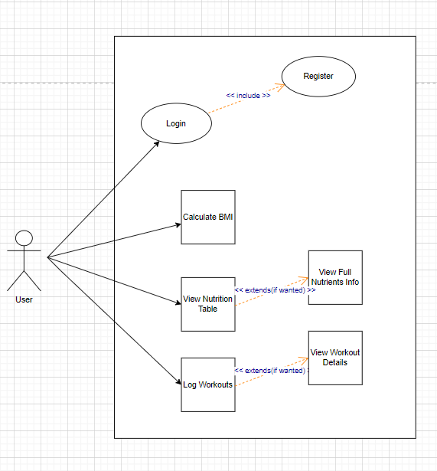
Fig 2 : Use-Case Diagram

Slide 12
Tools and Technology
Backend: NodeJs
Frontend: Html, Css and ReactJs
Database: Mongodb
Code Editor: VS-Code

Slide 13
Result
BMI Calculation
Access to Basic Food Nutrition table
Workout information and tutorial videos
Workout logging

Slide 14
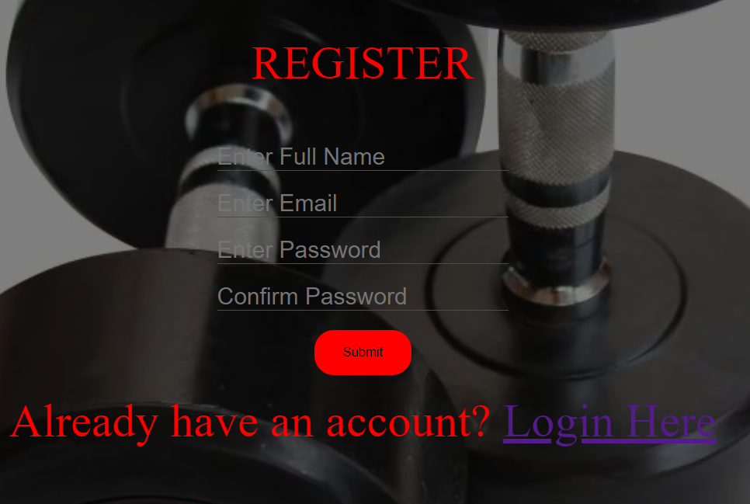
Register Page

Slide 15
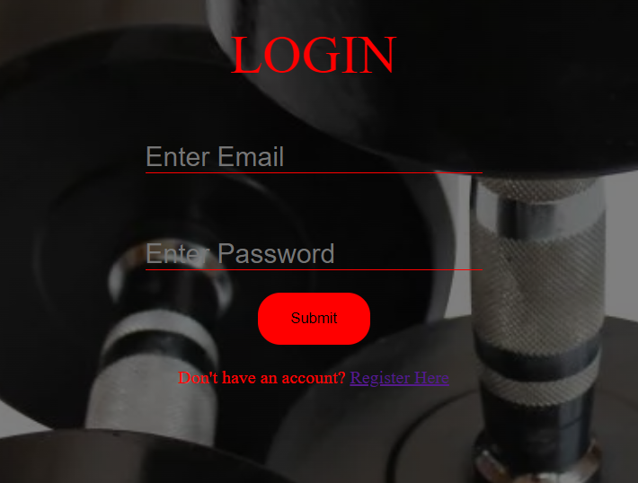
Login Page

Slide 16
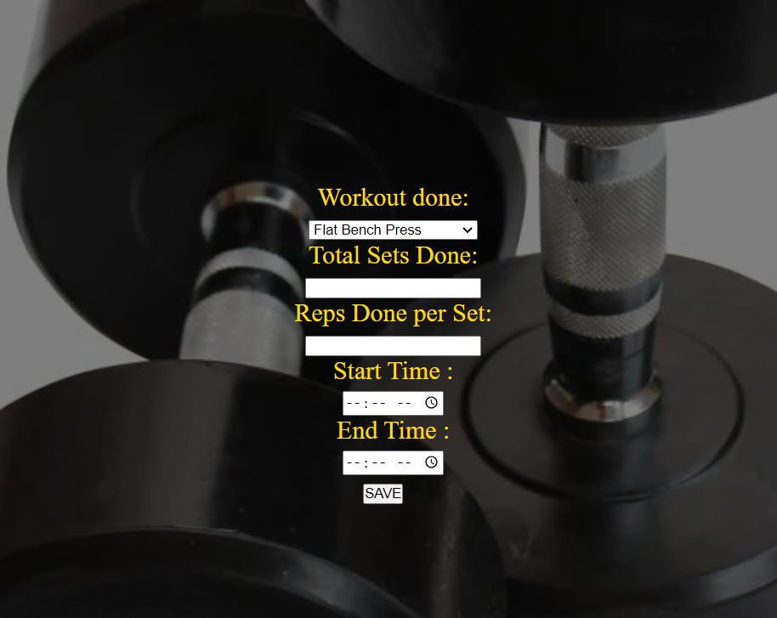
Workout Log Page

Slide 17
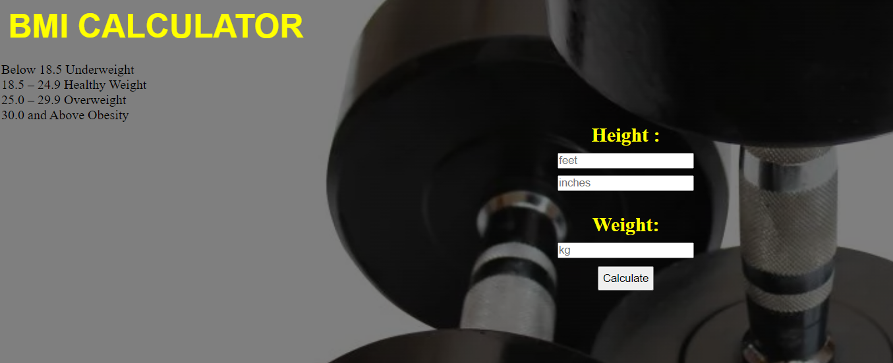
BMI Calculation Page

Slide 18
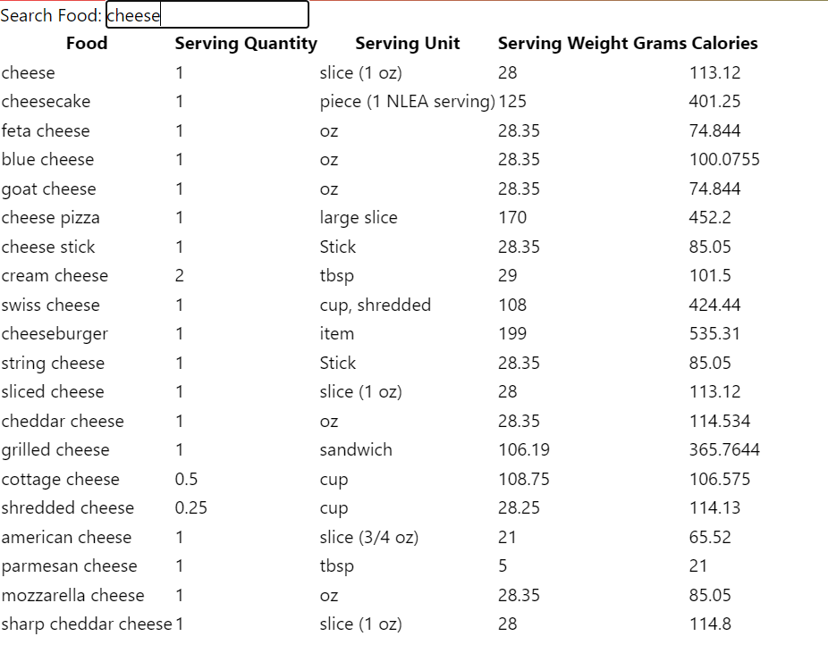
Food Nutrition Values

Slide 19
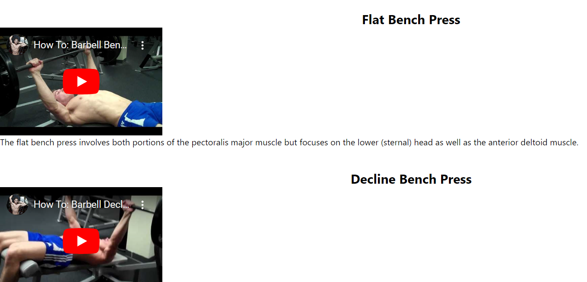
Workout Tutorials

Slide 20
Conclusion
The proposed app is a comprehensive health and fitness companion designed to facilitate a healthy lifestyle.
To sum up, I learned how MERN stack can be integrated in a project to develop an intuitive and user-friendly design.

Slide 21
References
[1] (n.d.). Retrieved August 1, 2023, from fullstackopen: www.fullstackopen.com
[2] Altexsoft. (2022, 07 26). Retrieved 06 08, 2023, from https://www.altexsoft.com/blog/non-functional-requirements/
[3] Nutritionix API Documentation. (2022). Retrieved June 2023, from Nutritionix: https://docs.google.com/document/d/1_q-K-ObMTZvO0qUEAxROrN3bwMujwAN25sLHwJzliK0/edit#heading=h.lfnb9dtubrav
[4] BMI. (n.d.). Retrieved July 2023, from RegisteredNurseRN.com: www.registerednursern.com
[5] draw.io. (n.d.). Retrieved 06 12, 2023, from https://app.diagrams.net/#G1YmzVMS0CB-kKwpCYmtfPENaRNP6M84-1
[6] Exercises. (n.d.). Retrieved August 2023, from Youtube.com: www.youtube.com

Slide 22
DEMO!!!!!

Slide 23
Thank You!!!!!

